Slide 1
DEPI-Recommendation
DEPI GRADUATION PROJECT
Presented by:
Omar Abdelwahab
Shehab Emad
Salma Mohamed
Engy Mahmoud

Slide 2
OVERVIEW
Description
This project is a simple distributed application designed to facilitate a voting system. It employs an automated deployment pipeline to ensure that updates and changes can be made seamlessly and efficiently.
Key Technologies
The system leverages cutting-edge technologies such as Jenkins for CI/CD, Docker for containerization, Docker Compose for run multi-container smoothly, Ansible for automation, and AWS for cloud hosting.

Slide 3
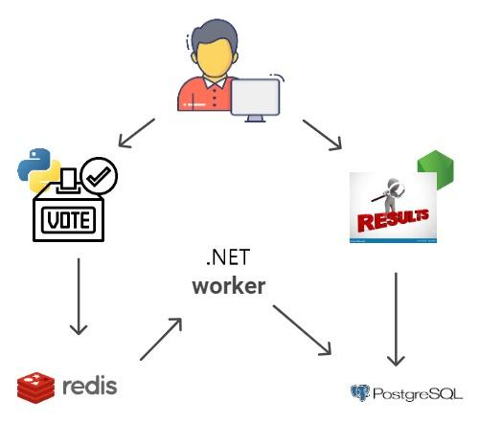
ARCHITECTURE
Components
Python front-end web app for voting.
Redis for vote collection.
.NET worker to process votes.
Postgres for storing results.
Node.js app to display all results.
Architecture Highlights
Multi-container deployment using Docker.
All services isolated in containers.

Slide 4
DOCKERIZATION OF APP
Docker Containers
Each service runs in its own container, encapsulating all dependencies and configurations.
Voting App: The Python application runs in a container that isolates it from other services.
Worker and Result Apps: These are also containerized, ensuring data management is consistent and isolated.
Advantages
Consistent Environments: Eliminates "it works on my machine" issues.
Isolation of Services: Enhances security and allows for independent scaling of components.

Slide 5
DOCKER HUB
Pushing Images
Jenkins automates the build process, generating Docker images for both the frontend and backend applications.
Once built, these images are pushed to Docker Hub, making them accessible for deployment on any server.
Advantages
This step ensures that the latest version of the application is always available and can be quickly deployed, improving the overall efficiency of the deployment pipeline.

Slide 6
DOCKER COMPOSE
Purpose
The Docker Compose file defines and manages multiple services in a single configuration file, simplifying the deployment process.
Services Include
The file specifies how to run Redis, Postgres, the Python app, and the Node.js result app together.
Benefits
Simplified Management: All services can be started and stopped with a single command.

Slide 7
AWS & ANSIBLE
AWS Setup
An EC2 instance is created to host the application, providing a scalable and reliable environment.
Ansible
Automates the provisioning process, including:
Installing Docker on the EC2 instance.
Configuring the Docker environment.
Deploying the application using Docker Compose.

Slide 8
JENKINS PIPELINE
Pipeline Overview
The Jenkins pipeline orchestrates the CI/CD process through defined stages.
Stages Explained
Checkout Code: Fetches the latest code from the Git repository to ensure up-to-date builds.
Build Docker Images: Compiles the application code and creates Docker images.
Push Docker Images: Uploads the built images to Docker Hub for easy access during deployment.
Deploy with Ansible: Utilizes Ansible scripts to automate the deployment of the application onto the EC2 instance.

Slide 9
DEMO
Walk through the Jenkins pipeline in action, highlighting each stage of the process.
Showcase how changes in code lead to automated builds and deployments.
Display the live voting application hosted on AWS, illustrating the end-user experience and real-time results.

Slide 10
ANY QUESTIONS?

Slide 11
Thank You!

